Slide 1
Table. 1
Name | Sequence (5′-3′) | Size (bp) | Note
V1 | S:AGGAGTCTGTGTGTGCCA AS:GAAGCCCAGAGATGTCCTGA |  | RT-PCR for identification of ACTR8 gene alternative transcripts
V2 | S:GTGCAGTGGCGTGATCTCT AS:AAGGTGTTGCAGAAGAAGACAA |  | RT-PCR for validation of Alu-exonized transcript
Original transcript | S:GGAATACTCGGCTTTGTCTG AS:TGAAGCCCAGAGATGTCCTG | 181 | RT-PCR for targeted to original transcript (XM_005547410) in primate and human
TV1 | S:GTCTCATCGGAATACTCGCATCT AS:TCTTGTTTGCTCTGTGTGGC | 270 | RT-PCR for targeted to TV1 that 8 exon skipping transcript (XM_015446035) in primate and human
TV2 | S:CTGAAAGTCCTGAATCTCACTC AS:ACTGGCATTCTCTGTAAGGGA | 221 | RT-PCR for targeted to TV2 transcript in primate
TV3 | S:CGGAATACTCGATAGAATCTCAC AS:CCAGGAAAAGATGCTGATC | 302 | RT-PCR for targeted to TV3 transcript in primate
TV4 | S:CGGAATACTCGATAGAATCTCAC AS:CCAGAGATGTCCTGATCTAAATGAC | 300 | RT-PCR for targeted to TV4 transcript in primate
TV5 | S:CGGAATACTCGATAGAATCTCAC AS:CCATTAAAGGCTGGGCATGG | 299 | RT-PCR for targeted to TV5 transcript in primate
TV6 | S:CGGAATACTCGATAGAATCTCAC AS:TGCCAGACAAAGCCTGTAATCCCAG | 282 | RT-PCR for targeted to TV6 transcript in primate
gPCR primer | S:TATGCTGTGTGGAGGATGGG AS:CTGGCATTCTCTGTAAGGGAAC | 1688 | Genomic for evolutionary analysis of AluSz6 insertion
GAPDH | S:GAAATCCCATCACCATCTTCCAGG AS:GAGCCCCAGCCTTCTCCATG | 120

Slide 2
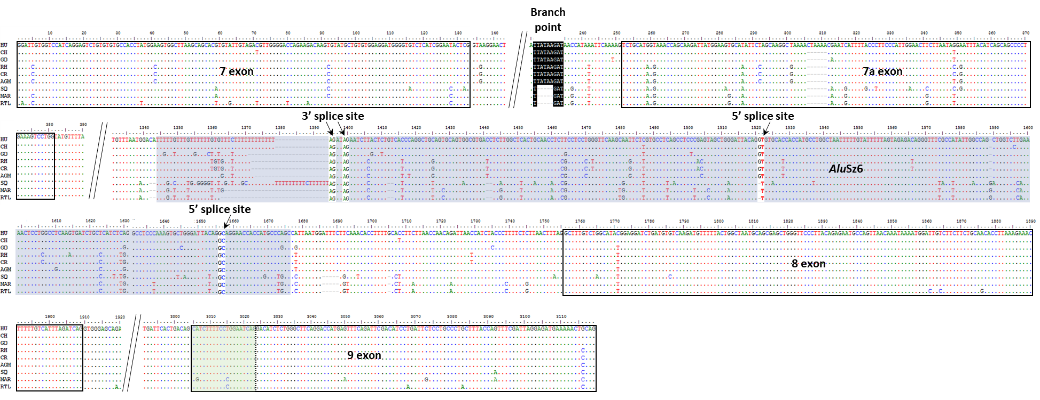
Fig. S1

Slide 3
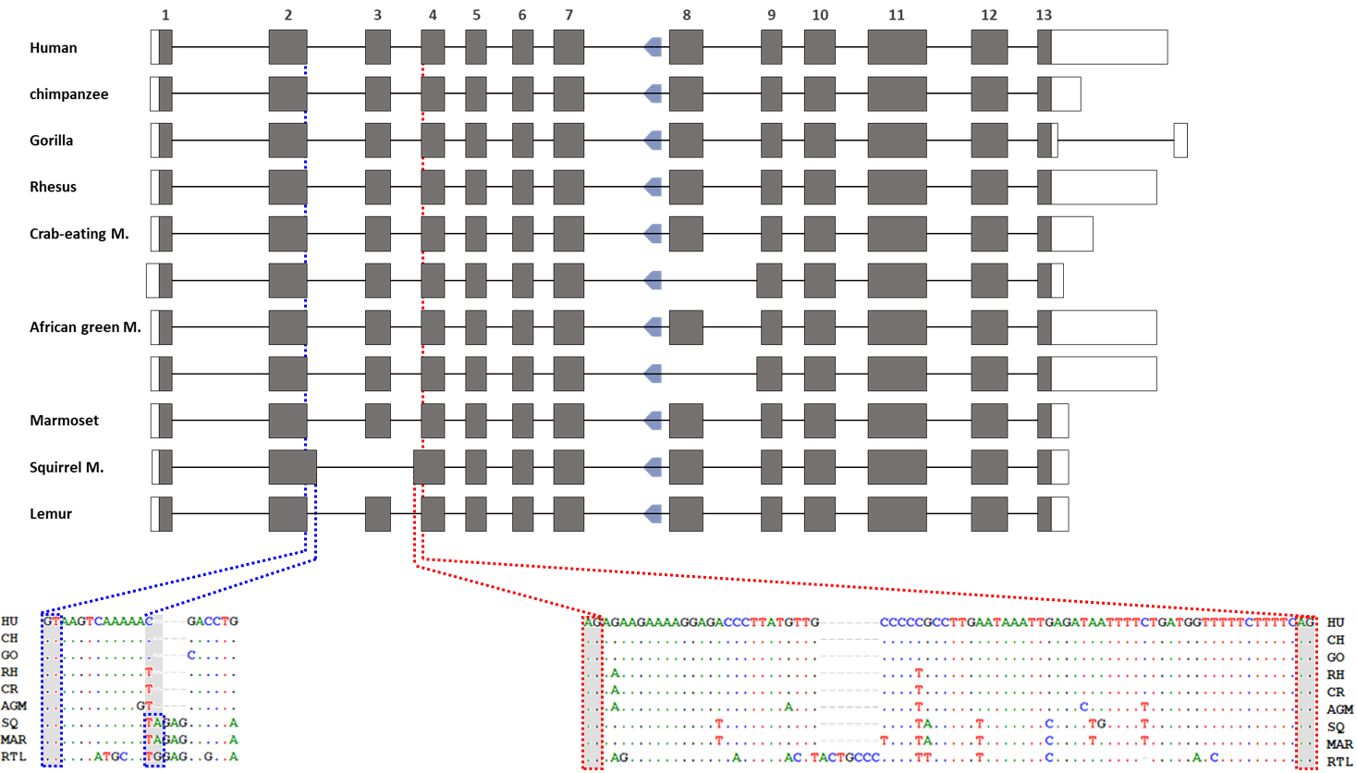
Fig. S2

Slide 4
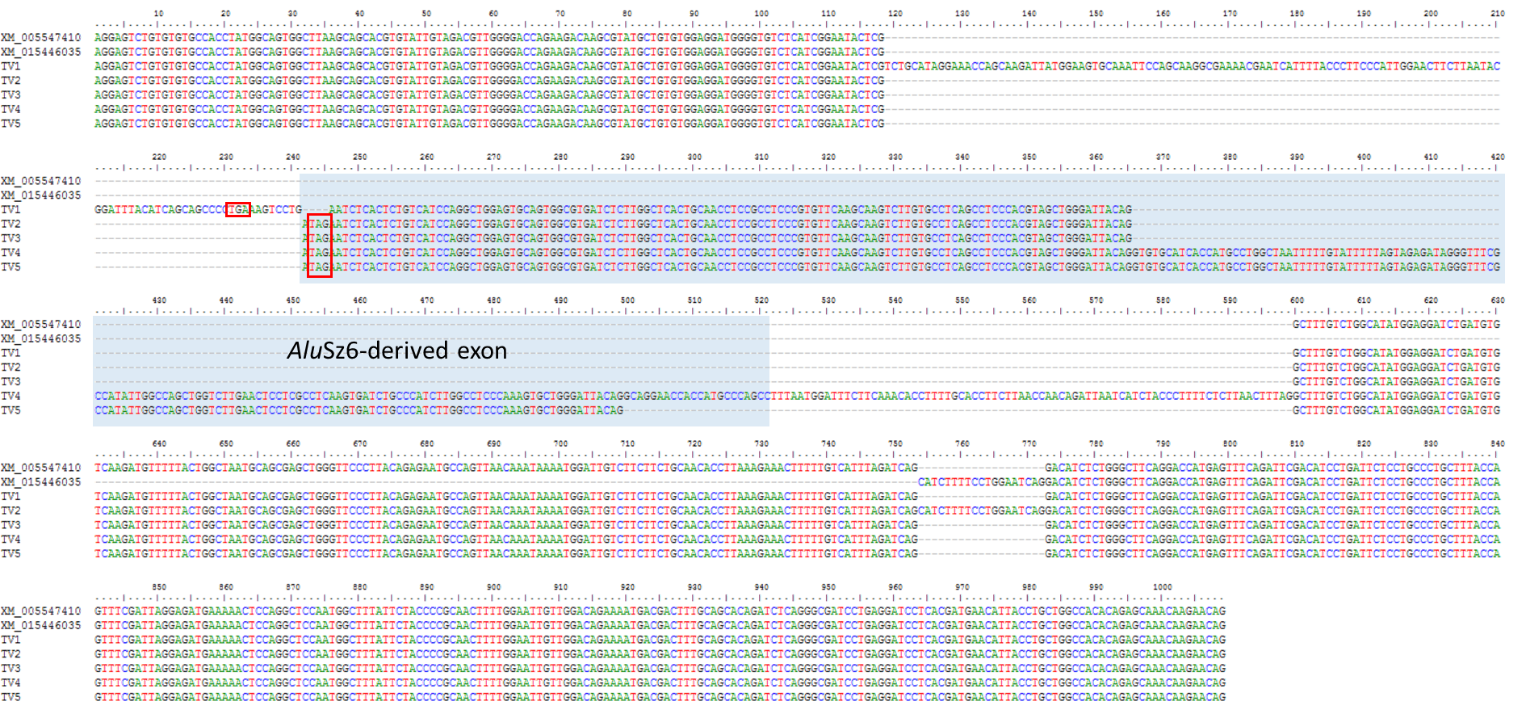
Fig. S3
Original transcript
TV1
TV2
TV3
TV4
TV5
TV6
Original transcript
TV1
TV2
TV3
TV4
TV5
TV6
Original transcript
TV1
TV2
TV3
TV4
TV5
TV6
Original transcript
TV1
TV2
TV3
TV4
TV5
TV6
Original transcript
TV1
TV2
TV3
TV4
TV5
TV6

Slide 5
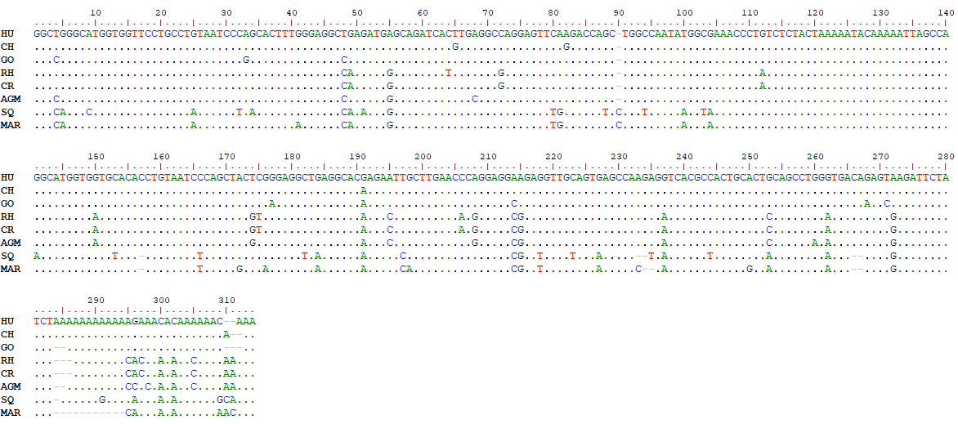
Fig. S4

Slide 6
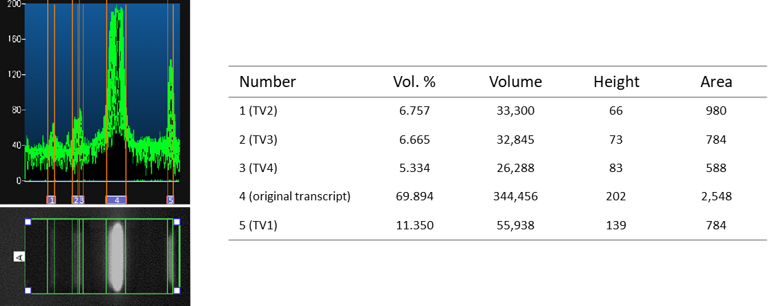
Fig. S5
A
B

